Slide 1
AWS Essentials
Security and Pricing
SoftUni Team
Technical Trainers
Software University
https://softuni.org

Slide 2
Table of Contents
1. AWS Shared Responsibility Model
2. Security and Compliance in AWS
3. AWS Key Management Service (KMS)
4. AWS Organizations
5. AWS Pricing and Billing
6. AWS Trusted Advisor
Notes:
2

Slide 3
Have a Question?
sli.do
# AWS-essentials
Notes:
3

Slide 4

Shared Responsibility Model

Slide 5
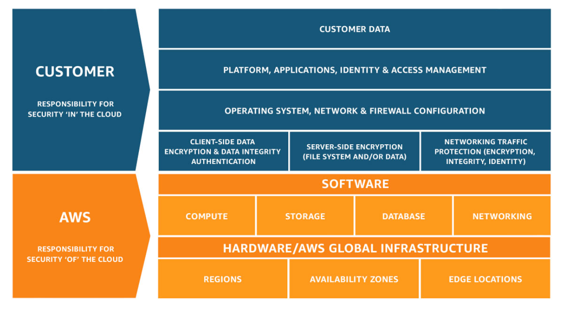
What is Shared Responsibility Model ?
The Model defines what you (as an AWS account owner/user) and Amazon Web Services, are responsible for when it comes to security and compliance

Slide 6
DDOS and Penetration Testing
AWS customers are allowed to carry out penetration testing or security assessments against some of AWS services without prior approval. The services are :
  EC2, NAT Gateways, ELB
  RDS, Aurora , Cloudfront
  API Gateway, Lambda, Lambda Edge
  Lightsail, Elastic Beanstalk
  AWS Penetration Testing

Slide 7
Other Security Related Services
AWS Organizations
Amazon GuardDuty
Amazon Inspector
AWS Shield
AWS Web Application Firewall (WAF)
AWS Artifact

Slide 8
AWS Key Management Service
Key Facts about KSM:
  Keys may be generated in KMS, or you can import your own Keys
  Data is submitted directly to KMS for encryption/decryption using the master keys
  KMS integrates with
    S3, Storage Gateway
    EBS, RDS, DynamoDB
    SNS, Cloudtrail

Slide 9

Billing and Support Services

Slide 10
What is AWS Organization ?
Main Features/Benefits:
  Centrally manage access policies across multiple AWS accounts
  Controll access to AWS services
  Automate AWS account creation and management
  Consolidate billing across multiple AWS accounts

Slide 11
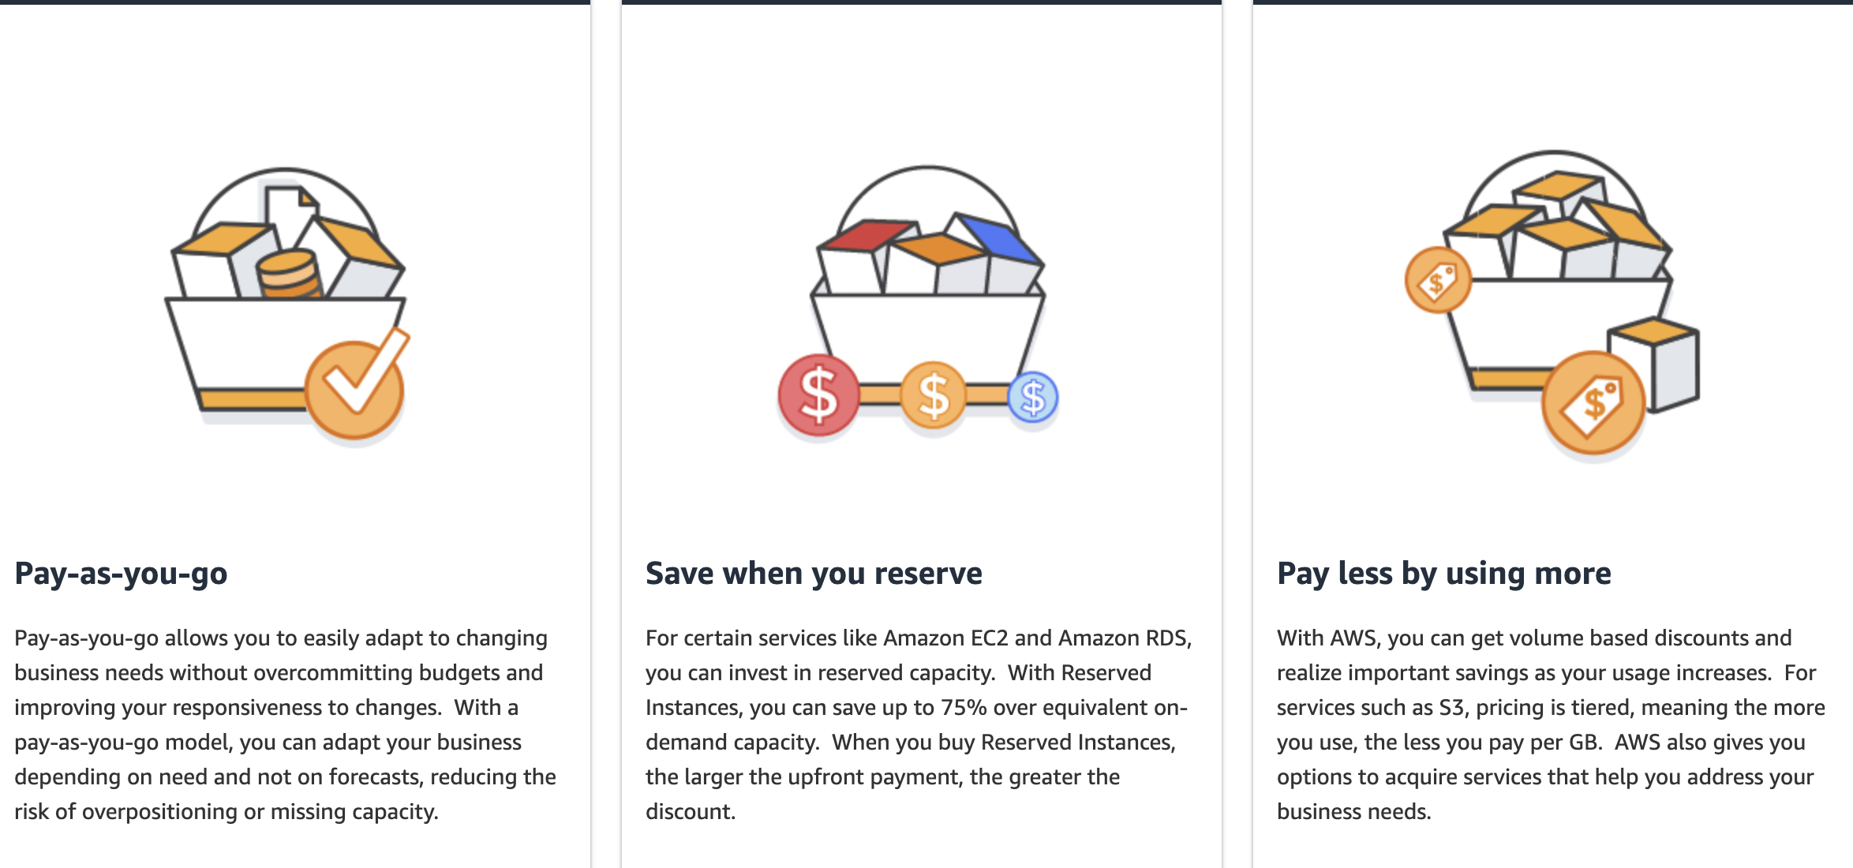
AWS Pricing Model
Notes:
11

Slide 12
How Does AWS Pricing Work ?
For S3 :
  How much data you store
  Request pricing - how much you move in/out of S3
For EC2:
  Purchasing options : on demand, spot, reserver
  Instance Type
  AMI Type
  Region

Slide 13
What is TCO Calculator ?
TCO Calculator
TCO is a free tool provided by AWS that allows you to estimate the savings of using the AWS Cloud, compared to on premises data center.
Helps you with guidance about cost savings

Slide 14
What is Simple Calculator ?
Simple Calculator
Used to calculated anticipated AWS monthly bill based on different scenarios.
It is being replaced by AWS Pricing Calculator

Slide 15
What is Cost Explorer ?
Free tool that allows you to view charts of your costs
View cost data for the past 13 months
Forecast future months payments
Help you identify cost problems and hot zones
Cost Explorer

Slide 16
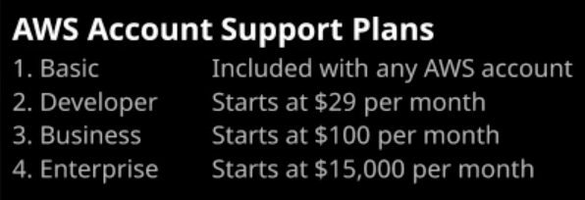
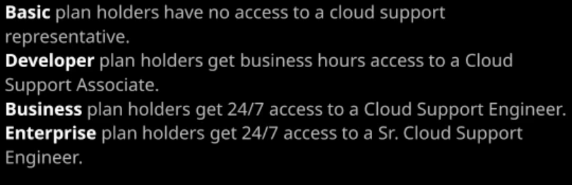
AWS Support Plans
Support Plans

Slide 17
What is Trusted Advisor ?
Resource that helps you reduce cost, increase performance, and improve security by optimizing AWS environment. Trusted Advisor provides real time guidance to help provision your resources.
Trusted Advisor
Provides help in 4 categories :
  Cost Optimization
  Performance
  Security
  Fault Tolerance

Slide 18

AWS Whitepapers
AWS Whitepapes
Service Documentation
Netflix path
Workshops
List of beginner/advanced workshops

Slide 19

Summary
AWS Shared Responsibility Model
Security and Compliance in AWS
AWS Key Management Service (KMS)
AWS Organizations
AWS Pricing and Billing
AWS Trusted Advisor
…
…
…

Slide 20
Questions?
Notes:
20

Slide 21














SoftUni Diamond Partners

Slide 22
Trainings @ Software University (SoftUni)
Software University – High-Quality Education, Profession and Job for Software Developers
  softuni.bg, softuni.org
Software University Foundation
  softuni.foundation
Software University @ Facebook
  facebook.com/SoftwareUniversity
Software University Forums
  forum.softuni.bg
Notes:
22

Slide 23

License
This course (slides, examples, demos, exercises, homework, documents, videos and other assets) is copyrighted content
Unauthorized copy, reproduction or use is illegal
© SoftUni – https://about.softuni.bg/
© Software University – https://softuni.bg
Notes:
23

